Slide 1

Welcome to the Tidyverse
Slides CC BY-SA RStudio

Slide 2
Outline
11/6 | Introduction and Visualize Data | 1:00 – 2:30
11/7 | Transform Data | 1:00 - 2:15
 | Break | 2:15 - 2:30
 | Model Data | 2:30 - 3:45
11/12 | Load Data | 1:00-2:15
 | Break | 2:15-2:30
 | Reproducible Reporting | 2:30 - 3:45
11/14 | Versioning | 2:00-3:00

Slide 3

Pop Quiz
What does IMRAD stand for? Poll your neighbors.
Introduction
What hypothesis was tested and why?
Methods
How was the study done?
Results
What answer was discovered?
And Discussion
What does the answer imply?
3
CC BY-SA RStudio

Slide 4
(Experimental) Science
IMRAD
Experiment
Data
Hypothesis
Conclusions
4
CC BY-SA RStudio

Slide 5
Pop Quiz
What is data science? Poll your neighbors.
5
CC BY-SA RStudio

Slide 6
Pop Quiz
What is data science? Poll your neighbors.
Science with non-trivial data?
6
CC BY-SA RStudio

Slide 7
Data Science
Experiment
Data
Hypothesis
Conclusions
CC BY-SA RStudio

Slide 8
Data Science
Data
Experiment
Visualize Transform
Model
Hypothesis
Conclusions
CC BY-SA RStudio

Slide 9
Data Science
Import
Data
Tidy
Visualize Transform
Model
Experiment
Hypothesis
Conclusions
CC BY-SA RStudio

Slide 10
Data Science
IMRAD
Import
+
Data
Tidy
Visualize Transform
Model
CODE
Experiment
Hypothesis
Conclusions
CC BY-SA RStudio

Slide 11
Data Science
Communicate
Import
Data
Tidy
Visualize Transform
Model
Experiment
Hypothesis
Conclusions
CC BY-SA RStudio

Slide 12
Data Science
Communicate
Import
Tidy
Visualize
Data
Import
Transform
Model
Experiment
Program
Hypothesis
Conclusions
CC BY-SA RStudio

Slide 13
(Applied) Data Science
Visualize
Import
Tidy
Model
Communicate
Transform
Program

Slide 14

₁1₇7

Slide 15
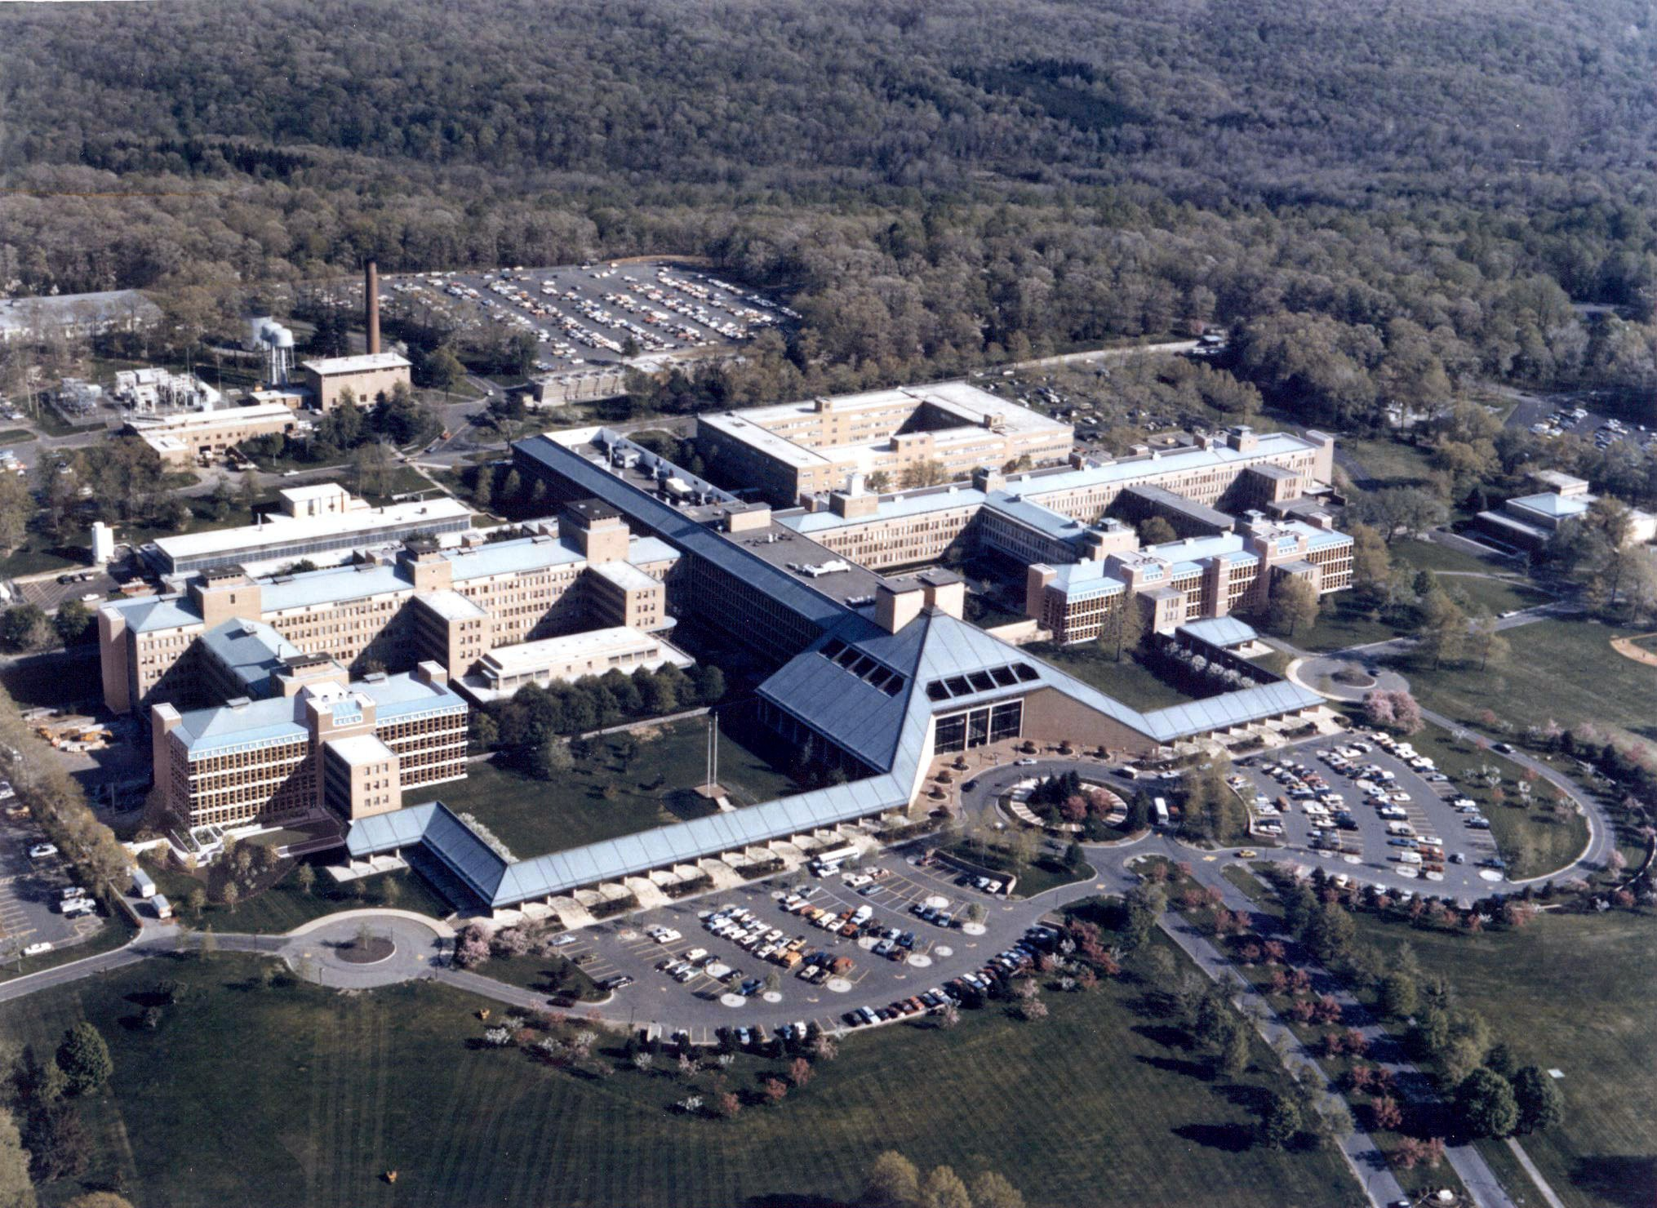
A language
₁1₈8

Slide 16

A language
Writing software

Slide 17
R the language
Values - 1, "Florida", "2010-01-25"

Slide 18
R the language
Values - 1, "Florida", "2010-01-25"
Objects - x <- 22/7
A value,
A name without quotes
< followed by -
(it looks like an arrow)
object, or function result

Slide 19
R the language
Values - 1, "Florida", "2010-01-25"
Objects - x <- c(22/7, 0.99, 3)
To put multiple values in an object, combine the values with c()

Slide 20
R the language
Values - 1, "Florida", "2010-01-25" Objects - x <- c(22/7, 0.99, 3) Functions - round(x, digits = 3)
A name without quotes
followed by () to run the function
Arguments: values, objects, or function results

Slide 21

Warm Up
Which of these are numbers?
1
"1"
"one"
one

Slide 22
Warm Up
Which of these are numbers?
1
"1"
"one"
one
number

Slide 23
Warm Up
Which of these are numbers?
"1" "one" words (strings)
1
one
number

Slide 24
Warm Up
Which of these are numbers?
"1" "one" words (strings)
1
one
number
object

Slide 25
Warm Up
Which of these will work? Suppose one <- 1.
log(1)
log("1")
log("one")
log(one)

Slide 26
Warm Up
Which of these will work? Suppose one <- 1.
log(1)
log("1")
log("one")
log(one)

Slide 27
Other Data Types
Datetime (POSIXct, date etc)
Factor
Numeric (real, decimal, complex/scientific)
Integer
Logical (boolean)
Vectors (lists) ie c(1, 2, 3, 4) or 1:4

Slide 28


R Function Syntax

Slide 29
R Functions
Functions - round(x, digits = 3)
A name without quotes
followed by () to run the function
Arguments: values, objects, or function results

Slide 30
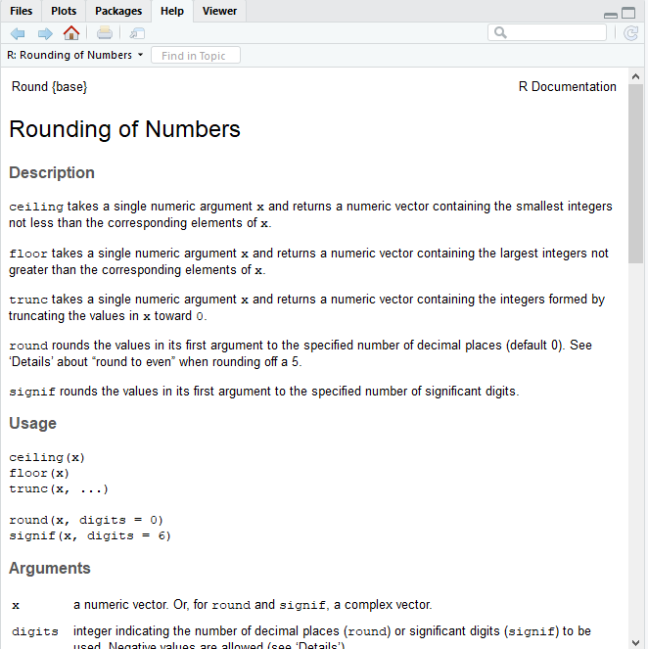
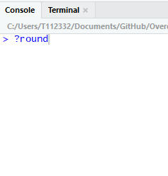
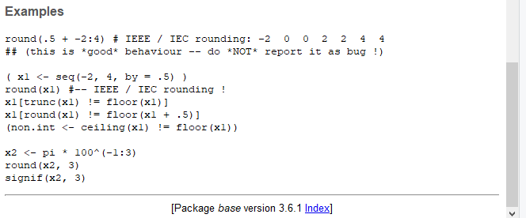
How do you use them?
Check the Documentation!

Slide 31
R Packages

Slide 32






help
help
help
function1() function2() function3() function4()
34

Slide 33











help
help
help
help
help
help
help
help
help
help
help
help
function1() function2() function3() function4()
function5() function6() function7() function8()
function9() functionA() functionB() functionC()
functionD() functionE() functionF() functionG()
Base R
35

Slide 34















help help help
function1() function2() function3() function4()
Base R
help
help
help
help
help
help
help
help
help
function5() function6() function7() function8()
function9() functionA() functionB() functionC()
functionD() functionE() functionF() functionG()
R Packages
36

Slide 35
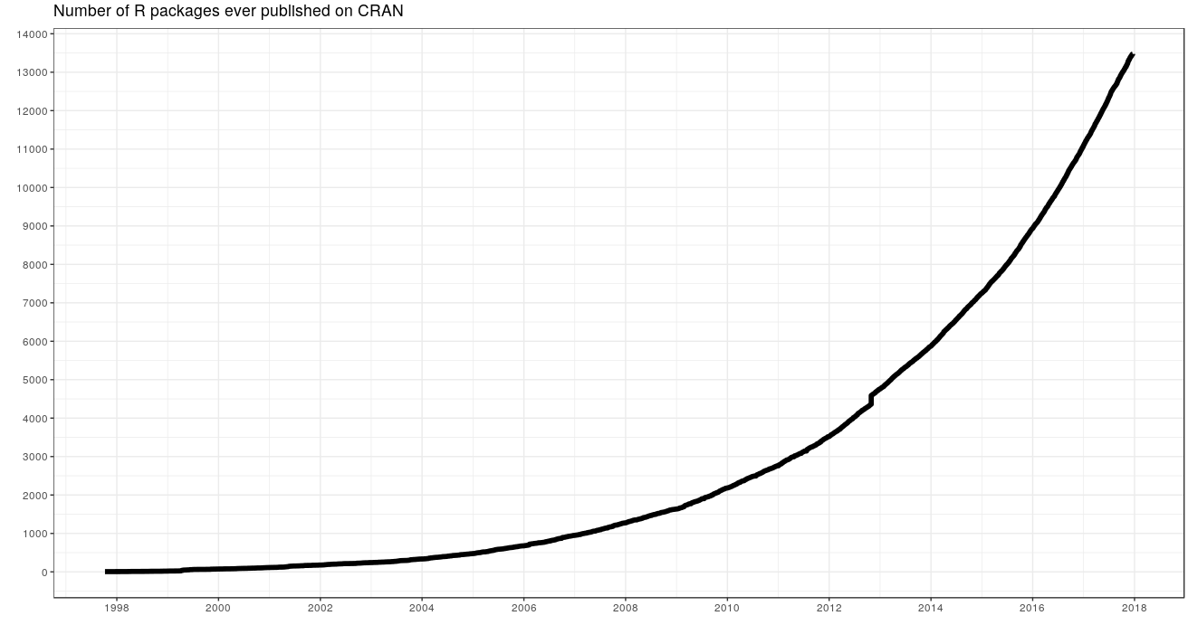
14108
packages
in 5/2019
37
Graph by https://besteamperu.org

Slide 36
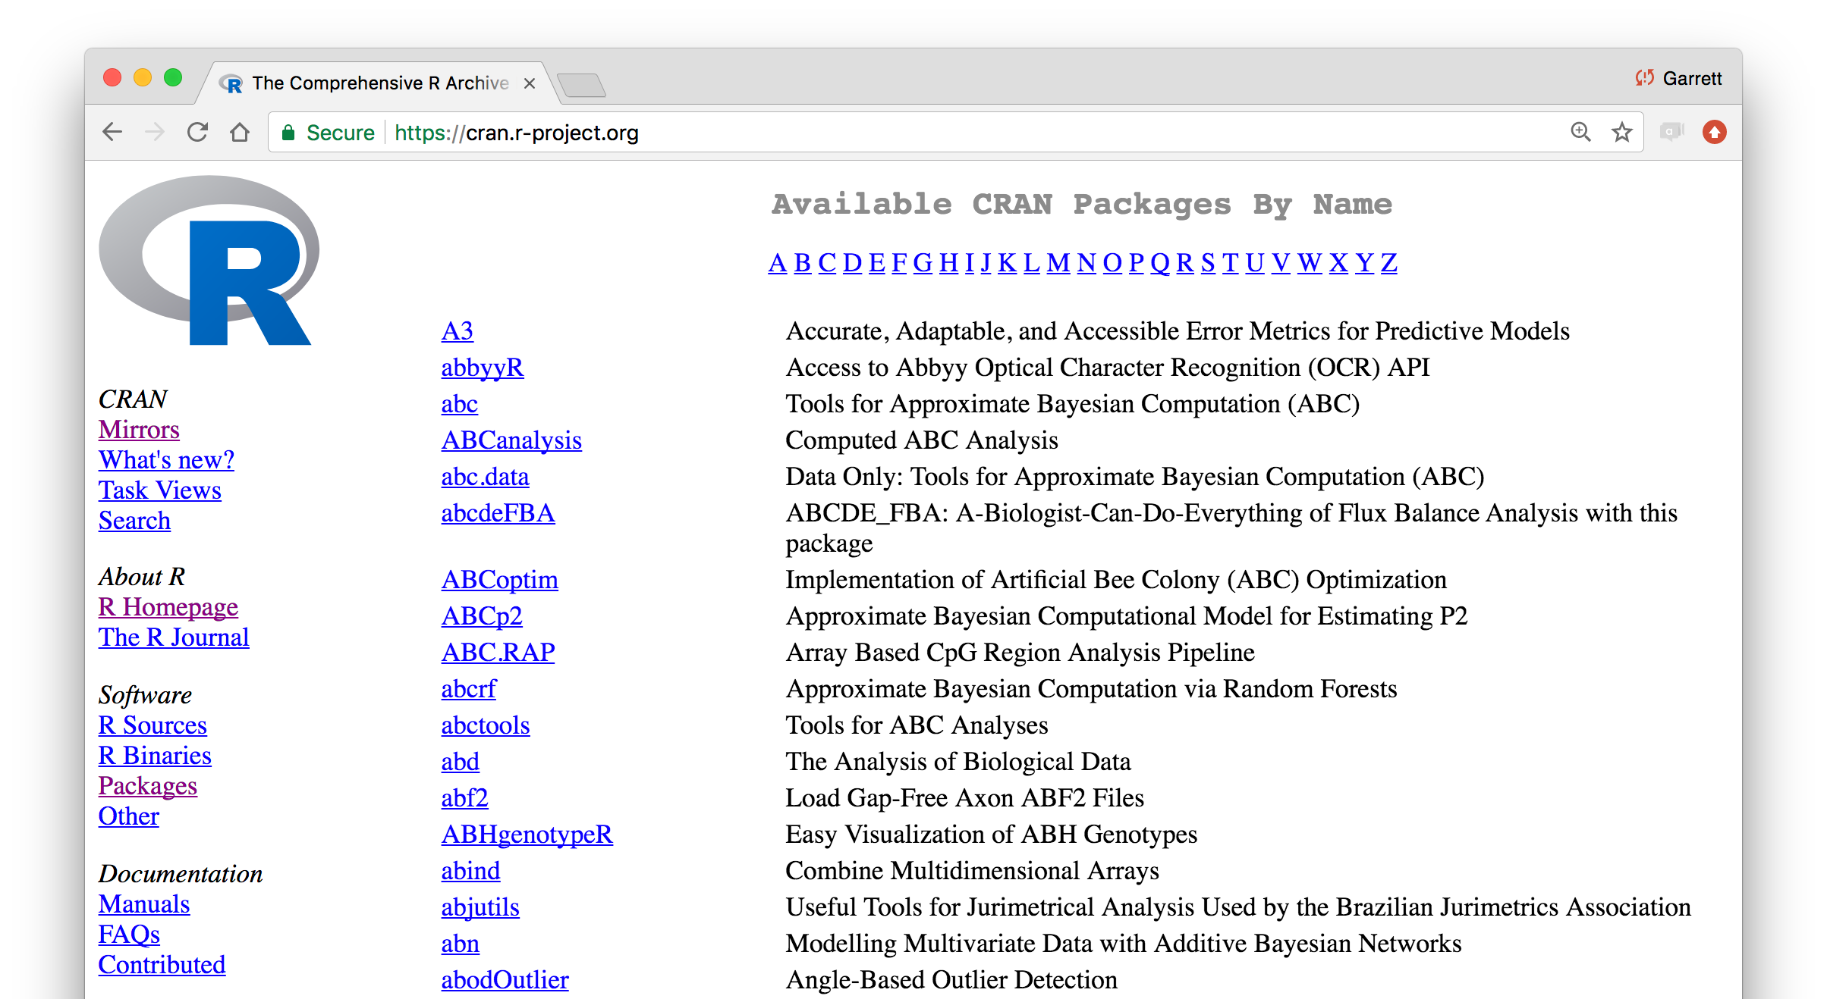

Slide 37
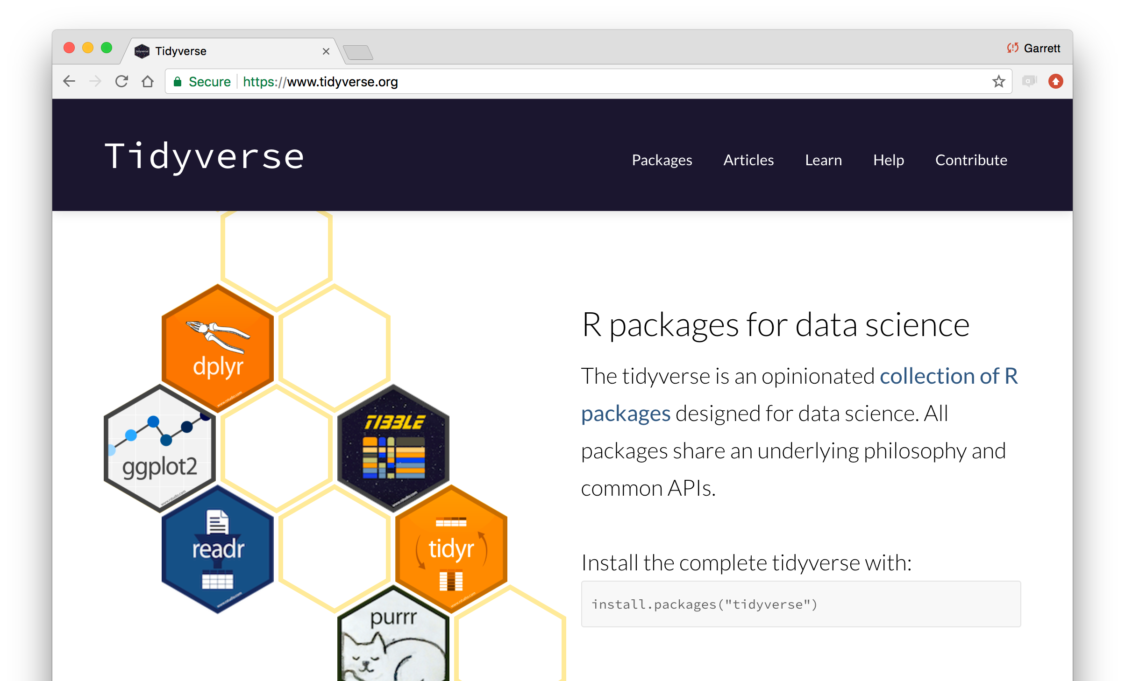
tidyverse.org

Slide 38
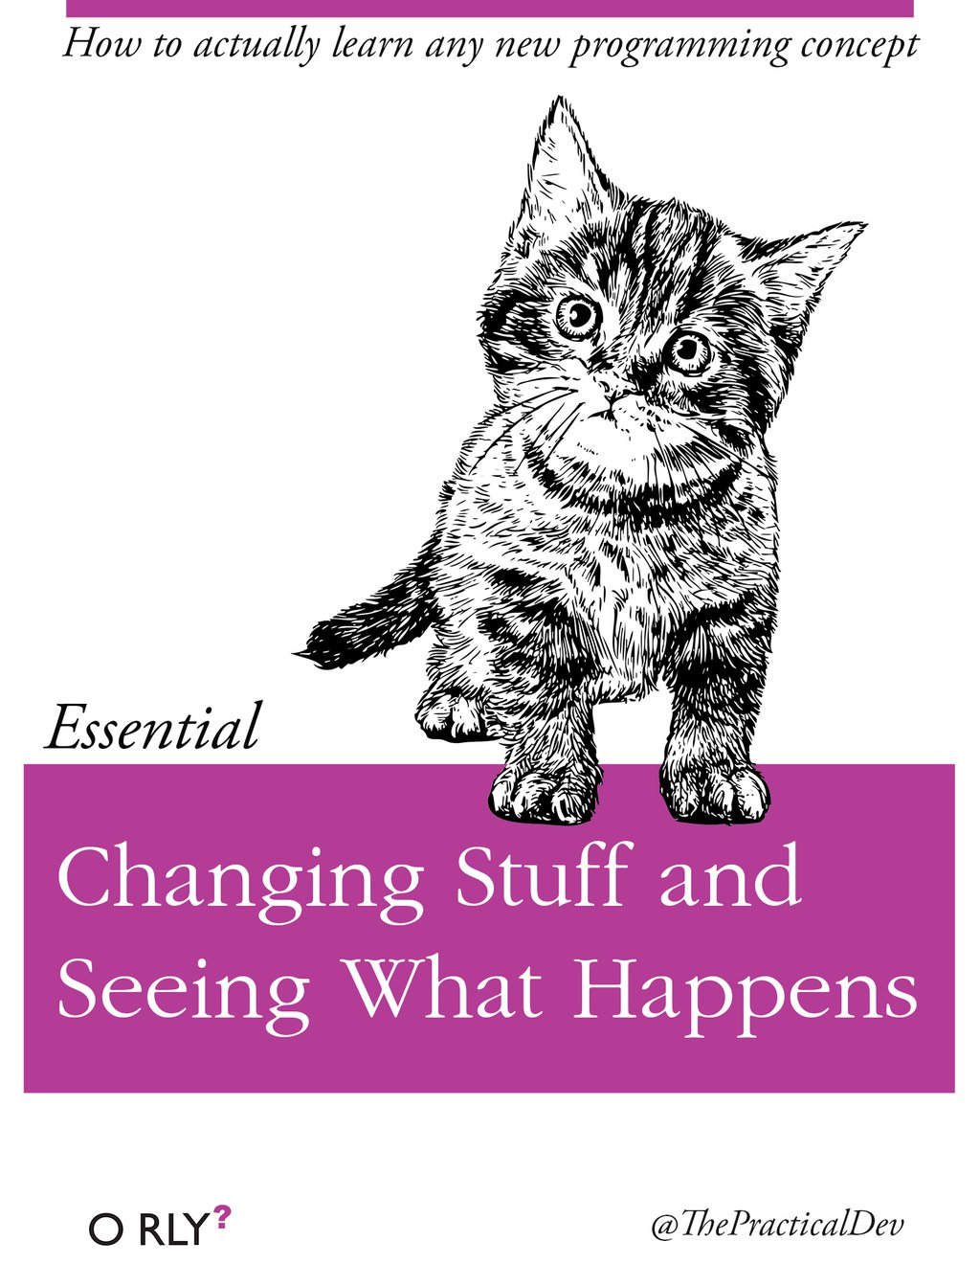
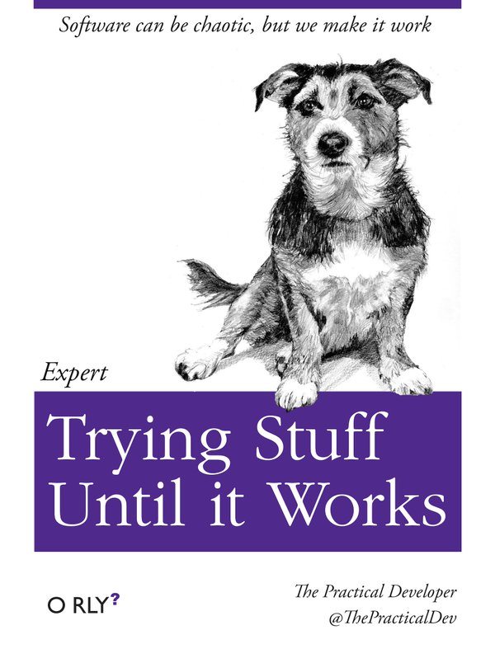
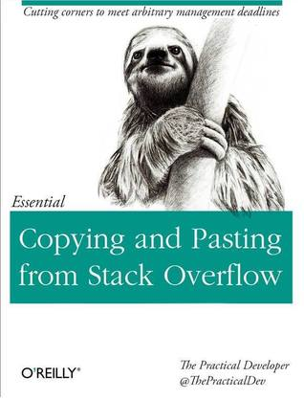
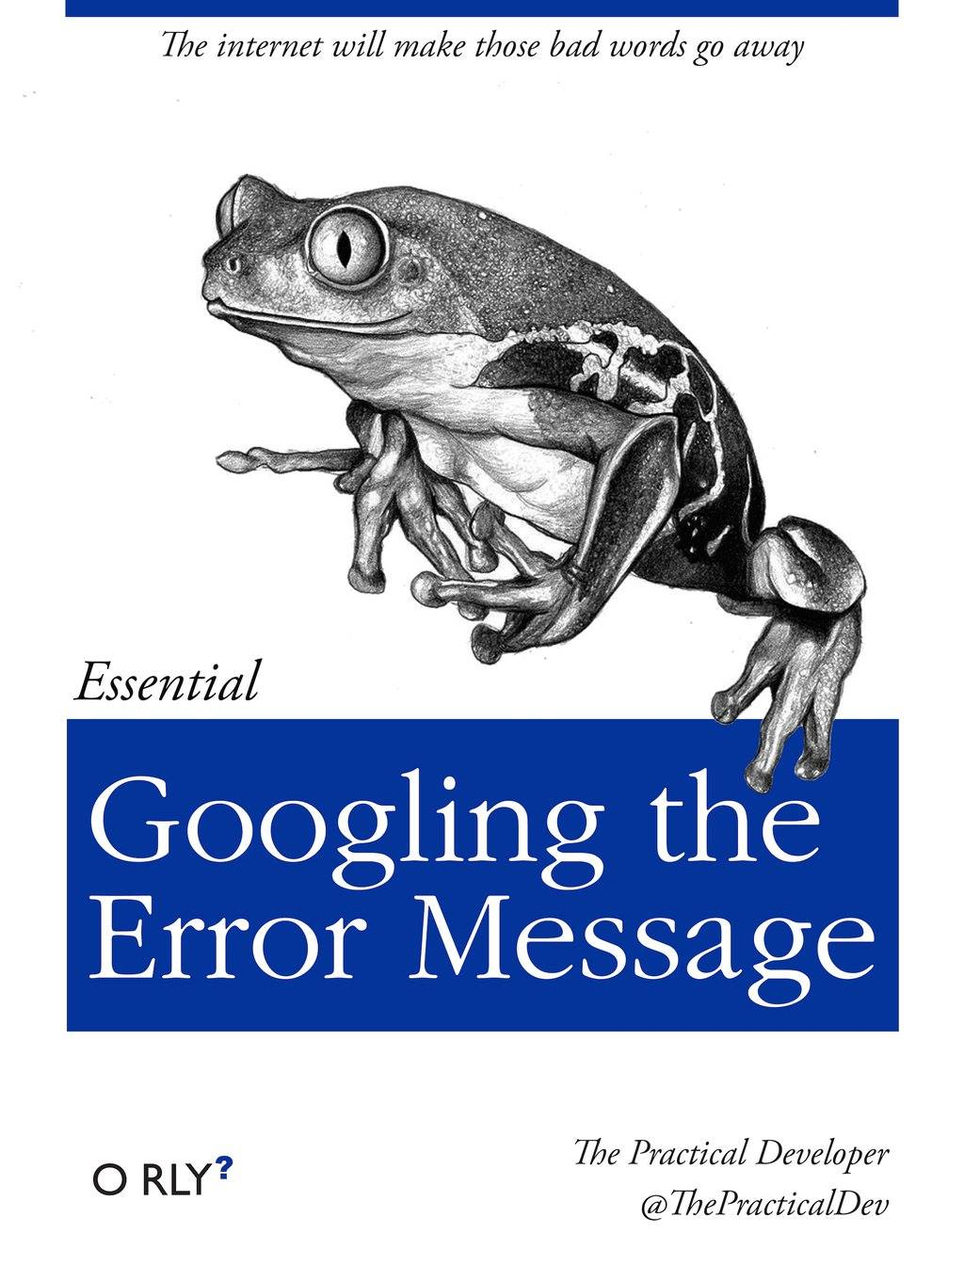
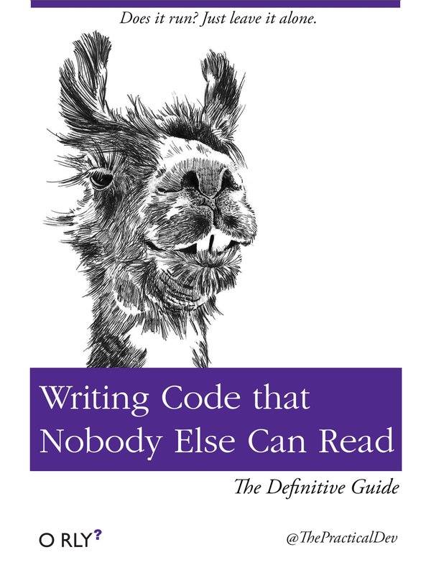

Slide 39
Using packages
1
install.packages("foo")
Downloads files to computer
1 x per computer

Slide 40
Pop Quiz!
The tidyverse contains the following packages. What function would you use to install them?
ggplot2 dplyr tidyr readr purrr
tibble hms stringr lubridate forcats
DBI
haven httr jsonlite readxl
rvest xml2 modelr tidyverse

Slide 41
install.packages("ggplot2") install.packages("dplyr") install.packages("tidyr") install.packages("readr") install.packages("purrr") install.packages("tibble") install.packages("hms") install.packages("stringr") install.packages("lubridate") install.packages("forcats") install.packages("DBI") install.packages("haven") install.packages("httr") install.packages("jsonlite") install.packages("readxl") install.packages("rvest") install.packages("xml2") install.packages("modelr") install.packages("broom")

Slide 42


tidyverse
An R package that serves as a short cut for installing and loading the components of the tidyverse.
install.packages("tidyverse")
A shortcut!

Slide 43

Your Turn
Go to Rstudio
Go to the console and type in: install.packages("tidyverse")

Slide 44
install.packages("tidyverse")
does the equivalent of
install.packages("ggplot2")
install.packages("dplyr") install.packages("tidyr") install.packages("readr") install.packages("purrr") install.packages("tibble") install.packages("hms") install.packages("stringr") install.packages("lubridate") install.packages("forcats") install.packages("DBI") install.packages("haven") install.packages("httr") install.packages("jsonlite") install.packages("readxl") install.packages("rvest") install.packages("xml2") install.packages("modelr") install.packages("broom")
need
ou
I've already installed all of
the packages y

Slide 45
Using packages
1 2
install.packages("foo")
library("foo")
Downloads files to computer
1 x per computer
Loads package
1 x per R Session

Slide 46
install.packages("tidyverse")
library("tidyverse")
does the equivalent of
does the equivalent of
install.packages("ggplot2")
install.packages("dplyr") install.packages("tidyr") install.packages("readr") install.packages("purrr") install.packages("tibble") install.packages("stringr") install.packages("forcats") install.packages("lubridate") install.packages("hms") install.packages("DBI") install.packages("haven") install.packages("httr") install.packages("jsonlite") install.packages("readxl") install.packages("rvest") install.packages("xml2") install.packages("modelr") install.packages("broom")
library("ggplot2")
library("dplyr")
library("tidyr") library("readr") library("purrr") library("tibble") library("stringr") library("forcats")

Slide 47
R Markdown

Slide 48
Your Turn
Go to 01-Introduction.
Open 01-RMarkdown-Exercises.Rmd. Read through the file and do everything it tells you to do.

Slide 49
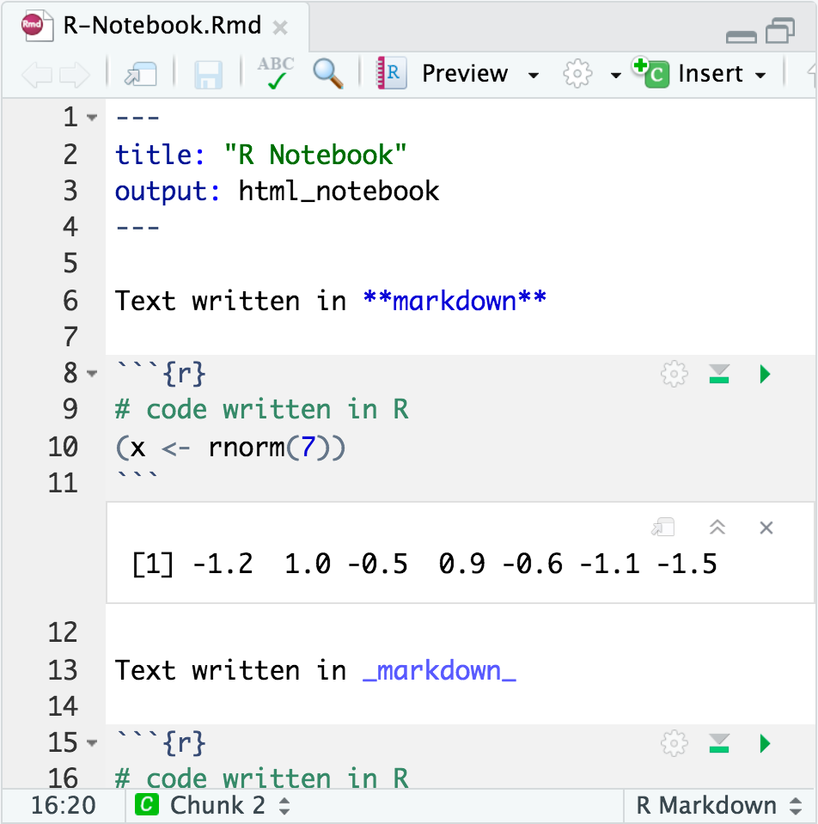

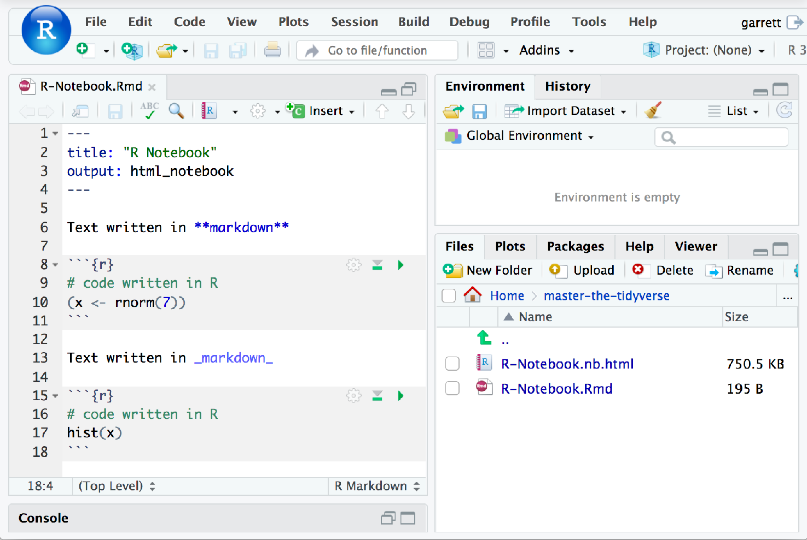
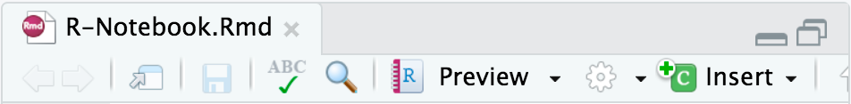
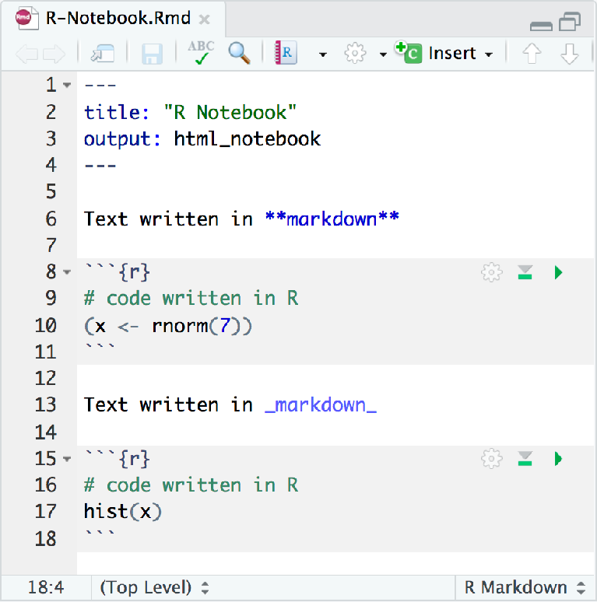
R Markdown
An authoring format for Data Science.
Code goes in a chunk
Click to run code in chunk
Click on .Rmd file to o^{C}pºe^{d}n^{e}n^{r}o^{e}t^{s}e^{u}b^{l}o^{t} ok

Slide 50



Code chunks
Insert a chunk of R code with
```{r}
# some code
```
⌘
Ctrl
+
+
Opt Alt
+
+
i i
(Mac)
(PC)
CC BY-SA RStudio

Slide 51

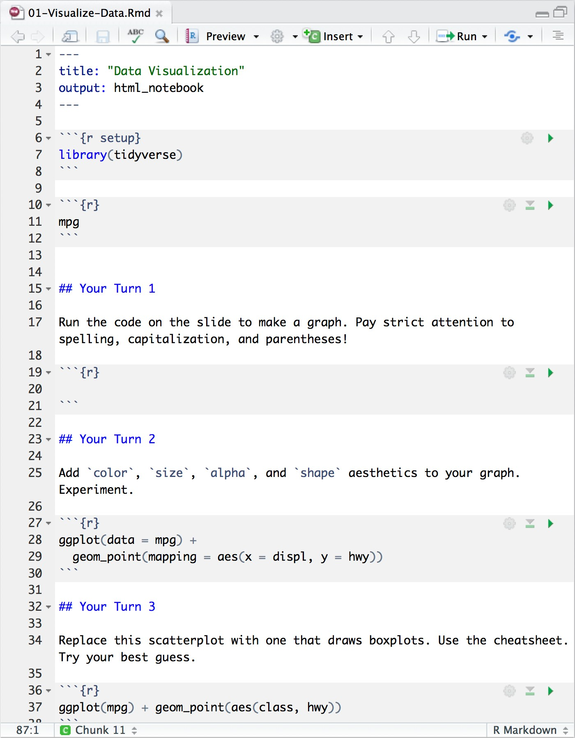


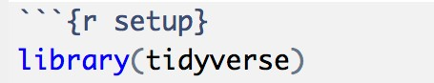
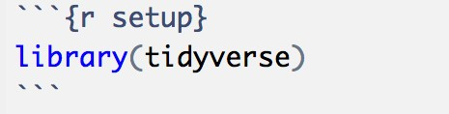
Setup
The setup chunk is always run once before anything else
chunk labels are optional, the setup label is special

Slide 52

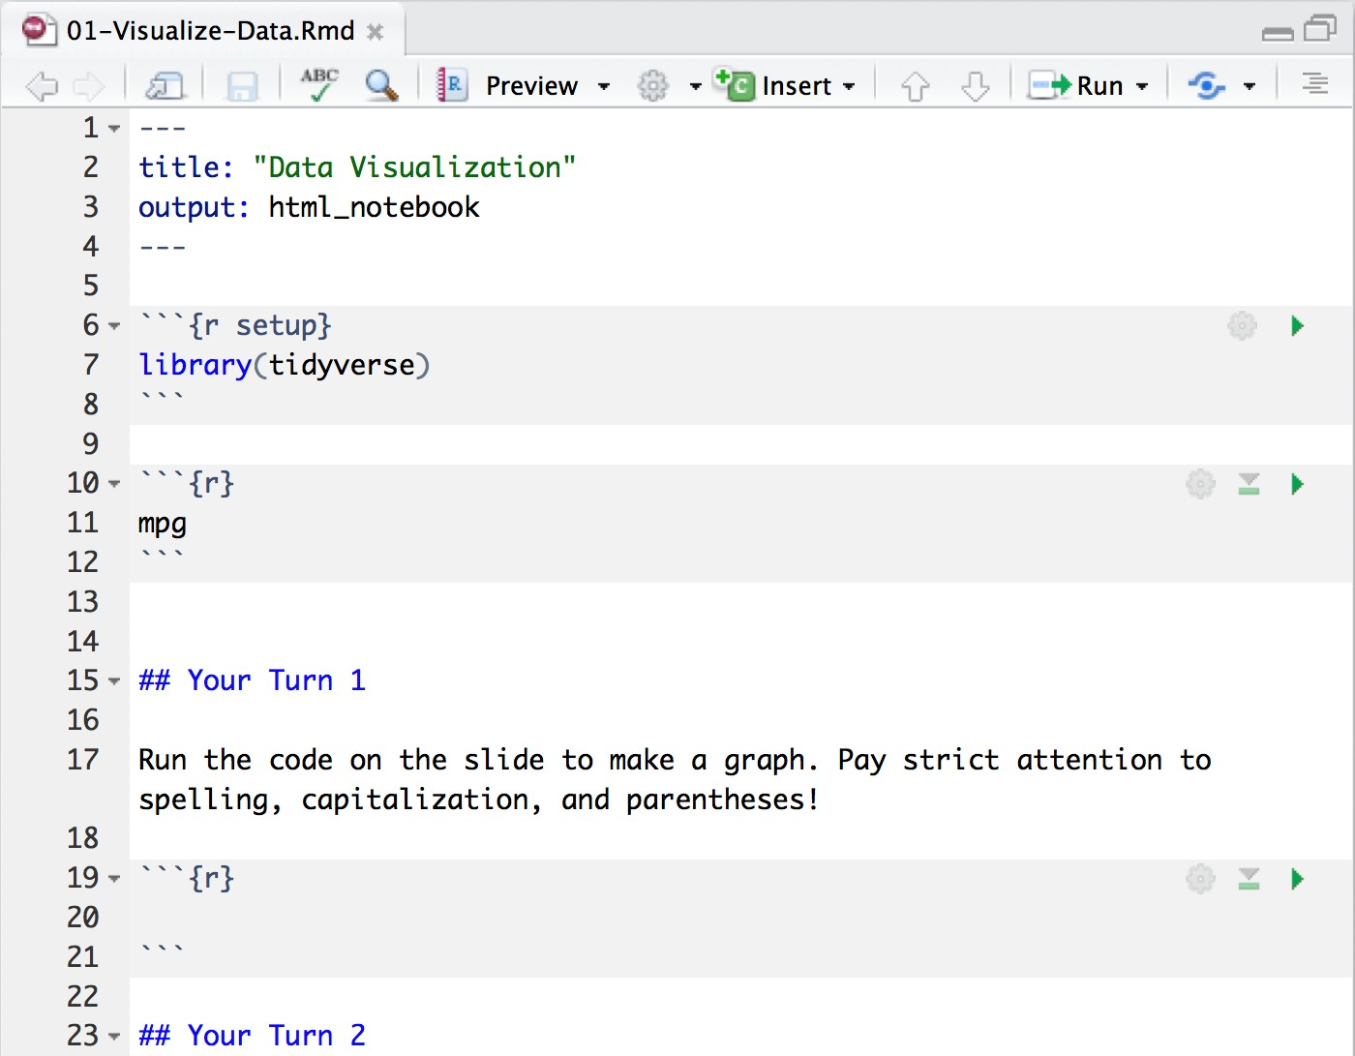
Your Turn
Add a setup chunk to the top of 01-RMarkdown- Exercises.Rmd. Use it to load the tidyverse package, then uncomment and run the ggplot2 chunk at the bottom of your file.
chunk labels are optional, the setup label is special

Slide 53
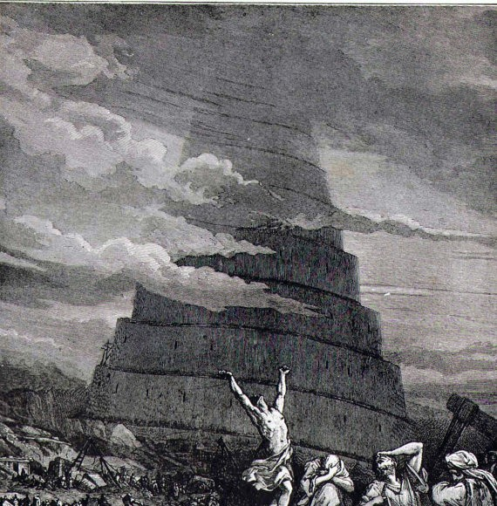

Slide 54
Your Turn 0
Navigate up to the 02-Visualize folder. Open 02-Visualize-Exercises.Rmd
Add a setup chunk that loads the tidyverse packages.

